Slide 1

TPS Reporting’s Weekly Report #1
Team Leader: Nicholas Alcorn
Other Members: Trevor Bal, Carl Moon II, Yasmina Rabhi, & Cameron Randolph

Slide 2
Tests
Steps for logging in: (Manual User Guide)
1. User enters domain name for login page into the browser and presses enter or clicks search;
2. User types in username and password into the corresponding field provided;
3. User clicks the submit button;
4. User re-enters username and password into the corresponding field provided and clicks submit (Only if username or password are incorrect);
5. User sees the home page that corresponds to their privilege level;

Slide 3
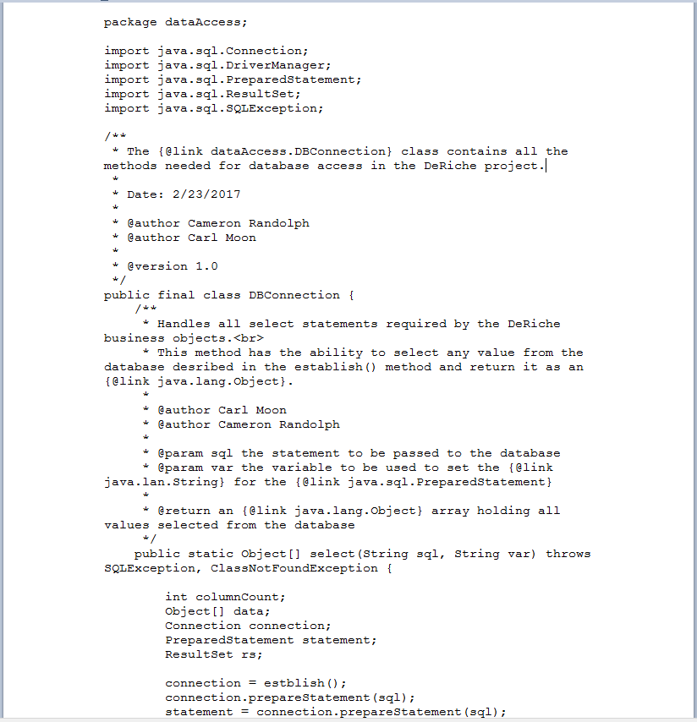
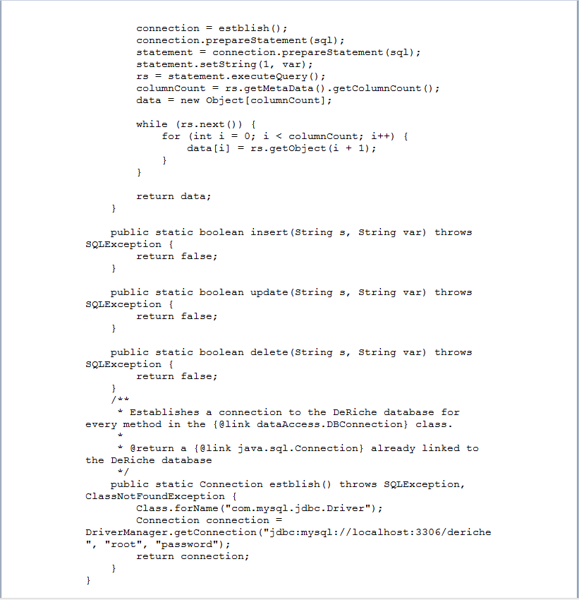
Running Code

Slide 4
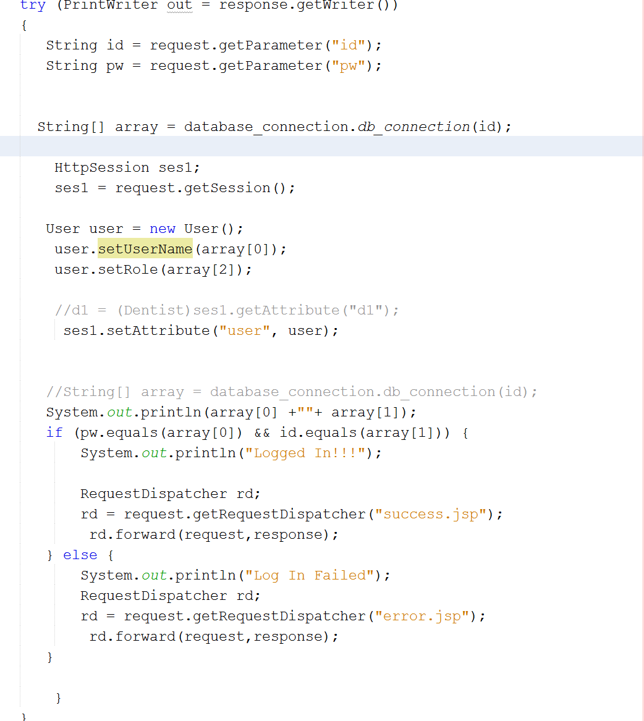
Running Code (Continued)

Slide 5
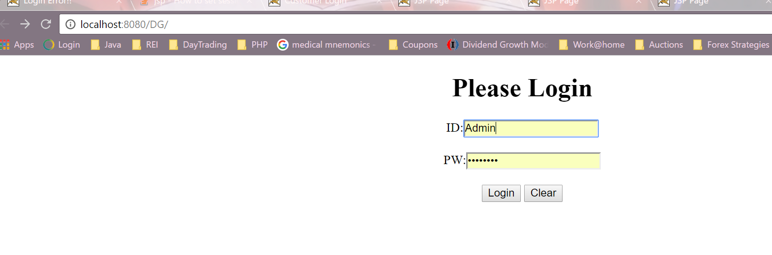
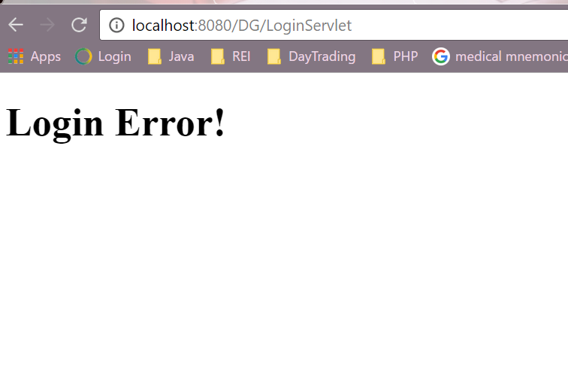
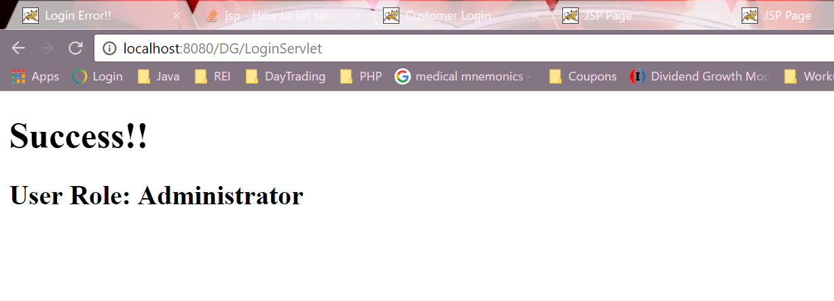
Running Code (Continued)

Slide 6
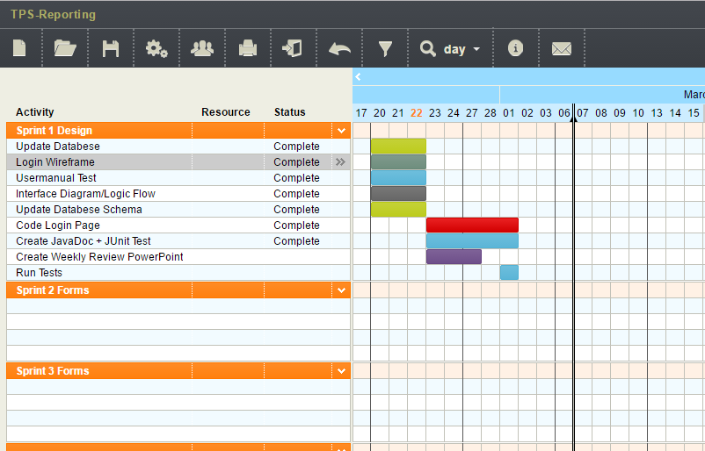

Project Plan

Slide 7
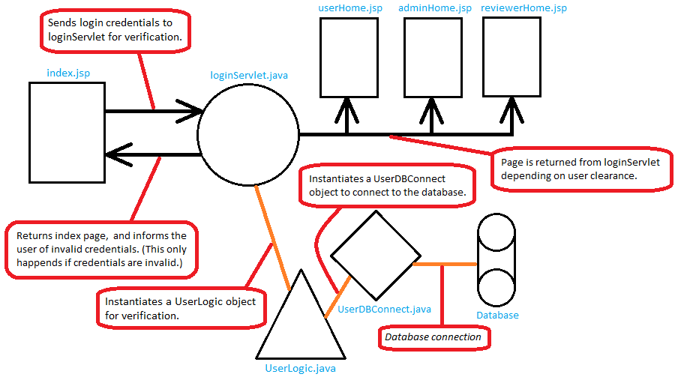
Deliverables
User Interface Design Flow

Slide 8
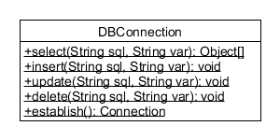
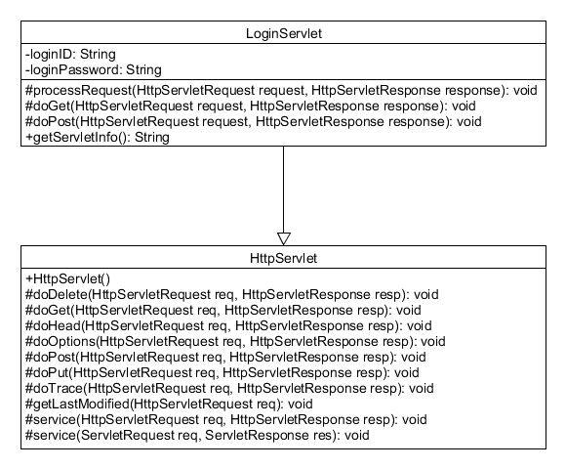
Deliverables (Continued)

